Slide 1
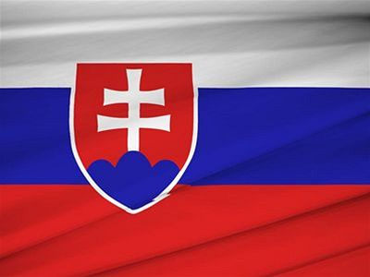
Slovakia

Slide 2
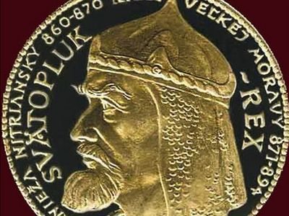
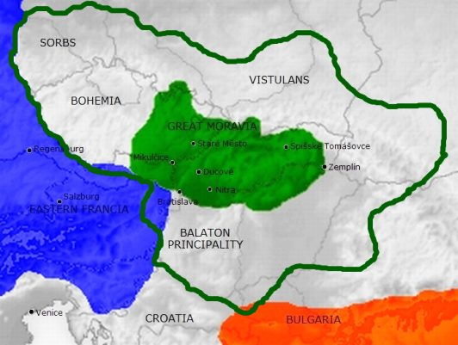
Great Moravia
In 833 Slovakia belong to Great Moravia, together with Hungary and Czech Republic. Sovereigns of the country was Mojmir, Rastislav, Slavomir, Svatopluk and Mojmir second.
Svatopluk

Slide 3
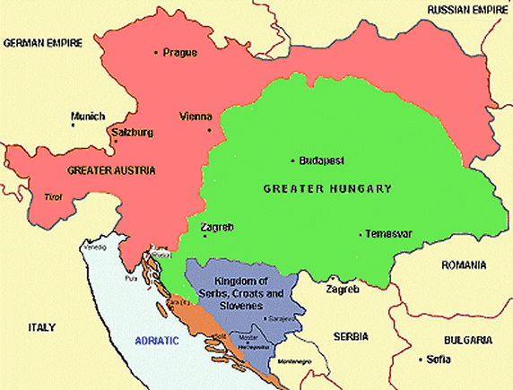
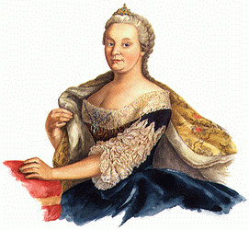
Austria–Hungary
After Great Moravia Slovakia belong to the Austria-Hungary. The most famous empress was Maria Theresa.
Maria Theresa

Slide 4
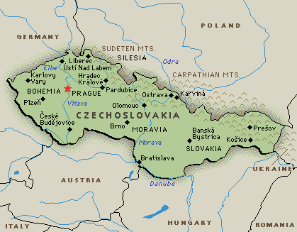
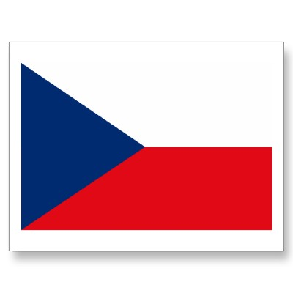
Czecho-Slovakia
After World War 2 Slovakia belonged to Czechoslovakia. It was a communist state.Slovakia belong to Czechoslovakia to year 1989.

Slide 5
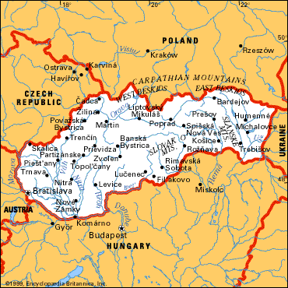
In 1989 In 1989, Czecho-Slovakia disintegrated in 1993 originated Slovakia. The first president of slovakia was Michal Kováč.

